Slide 1








GAME IDEAS

Slide 2
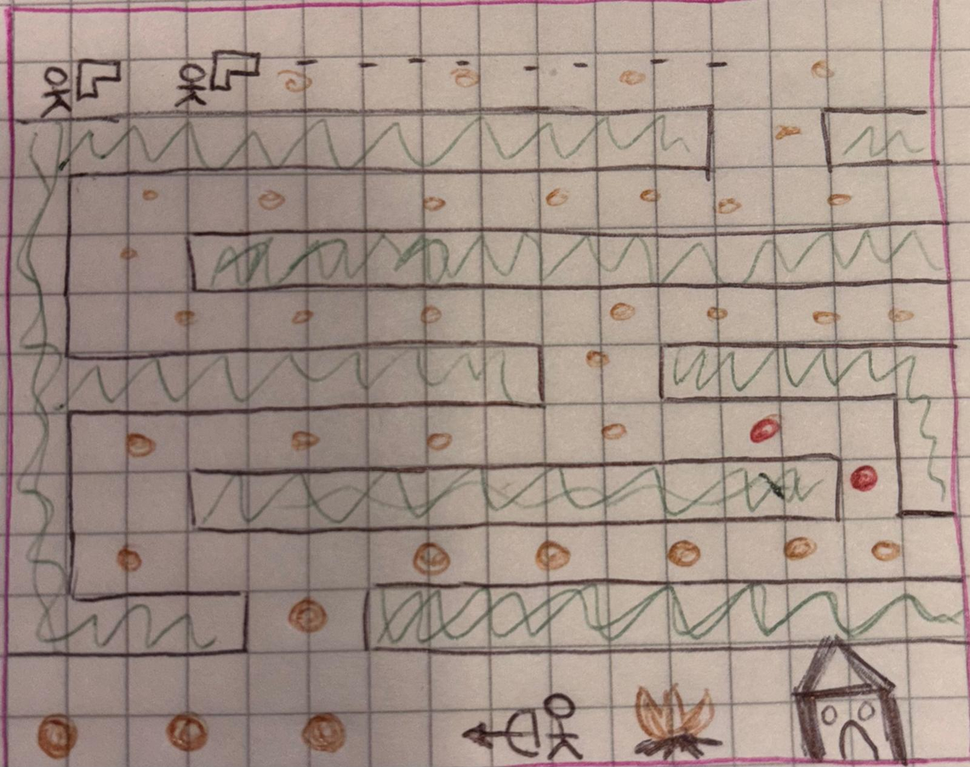

Abya Yala Freedom Fighters
Story: Defend Indigenous lands from invading colonizers trying to steal your community’s gold.
Objective: Protect the territory, collect gold, and defeat enemies before they take all the gold.
Genre: Platform game, Fast-paced top-down action game.

Slide 3
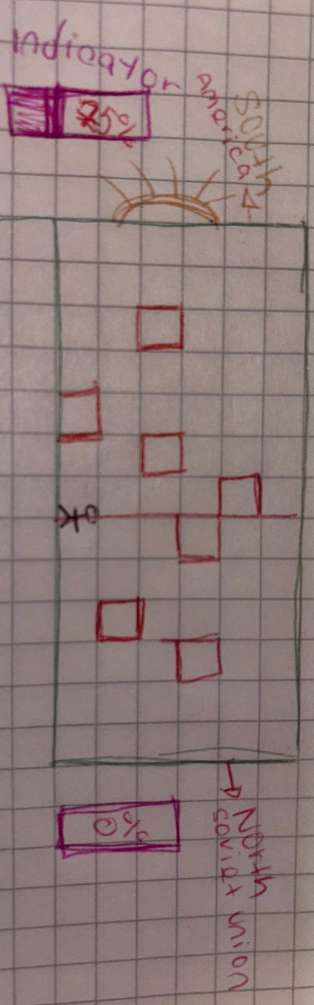
fragile steps in the crossfire
Story: A young boy abandoned by the army during the Vietnam War must navigate a forest filled with landmines and enemy soldiers to reach the nearest city and find his family.
Objective: Avoid mines and reach safety while managing limited time and lives.
Genre: puzzle game, top-down.
Additional Details: Includes strategic mine indicators to help players navigate through a gritty, war-torn environment.

Slide 4
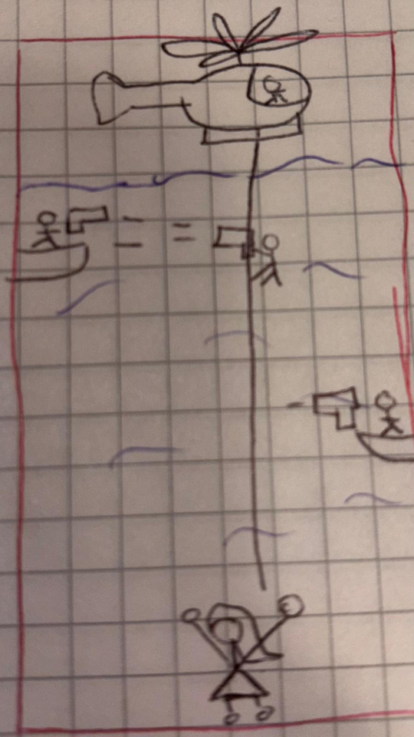
Crazy Hoist Rescues
Story: A skilled helicopter pilot must rescue a woman kidnapped by a dangerous mafia cartel, navigating enemy gunfire to ensure her safety.
Objective: Rescue the woman, shoot enemies, and dodge bullets within a time limit.
Genre: top-down shooting game.

Slide 5
Mortal Maze Runner
Story: Players are trapped in a massive, ever-changing maze and must escape before time runs out while avoiding a deadly robotic monster.
Objective: Navigate the maze, evade the monster, and escape before getting caught, using limited lives and time.
Genre: Fast-paced, top-down maze game.
inspired by tutankham

Slide 6
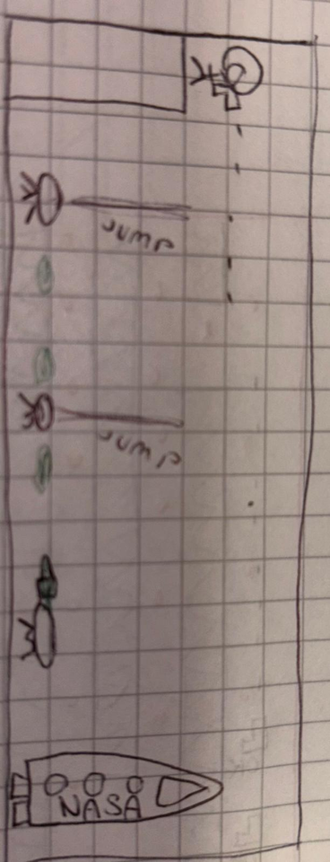
Astro-Bob
Story: An astronaut stranded on Mars must navigate the planet filled with alien threats to reach his spaceship and report the discovery of extraterrestrial life.
Objective: Avoid alien attacks, survive environmental hazards, and return to the ship.
Genre: Side-scrolling action game.

